Slide 1
Logbook-July-2

Slide 2
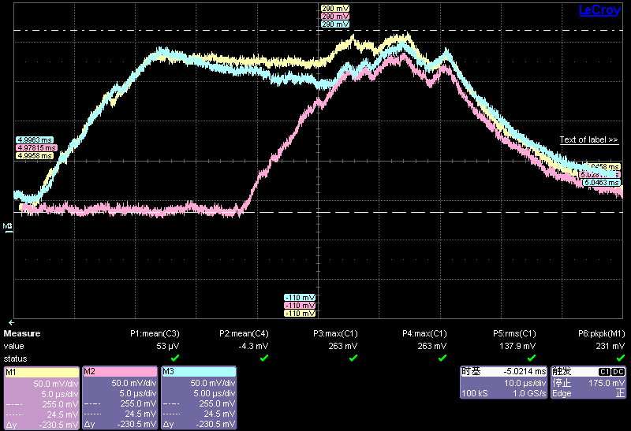
255mV
ADC Reading
25mV

Slide 3
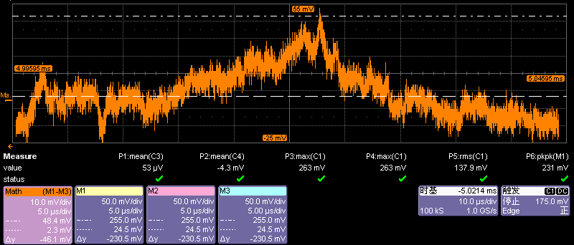
Voltage increase caused by the extra computation of detection

Slide 4
